Slide 1
From C++ to Flash: The Power of the Adobe Flash C++ Compiler
Alexander Macdonald | Sr. Computer Scientist
Notes:
Using the Adobe Flash C++ compiler to bring native code to the web

Slide 2
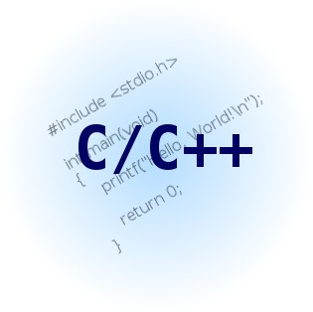


Overview
Notes:
-- use any combination of C/C++ and AS3 to create SWFs and SWCs
-- Easy interop between the languages
-- managed/unmanaged languages operating together

Slide 3
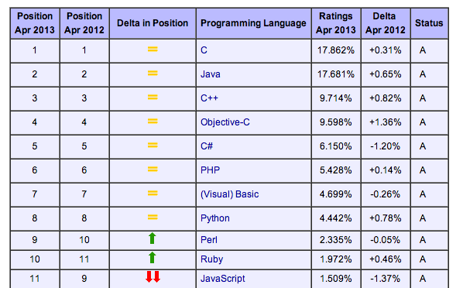
Why C/C++?
http://www.tiobe.com/index.php/content/paperinfo/tpci/index.html
Notes:
-- why are we interested in old unmanaged languages?
-- C/C++ consistently show up at the top of the list
-- C overtook Java last year
-- increased interest in Objective-C due to iOS
-- want to bring this expertise and existing code over to the Web

Slide 4
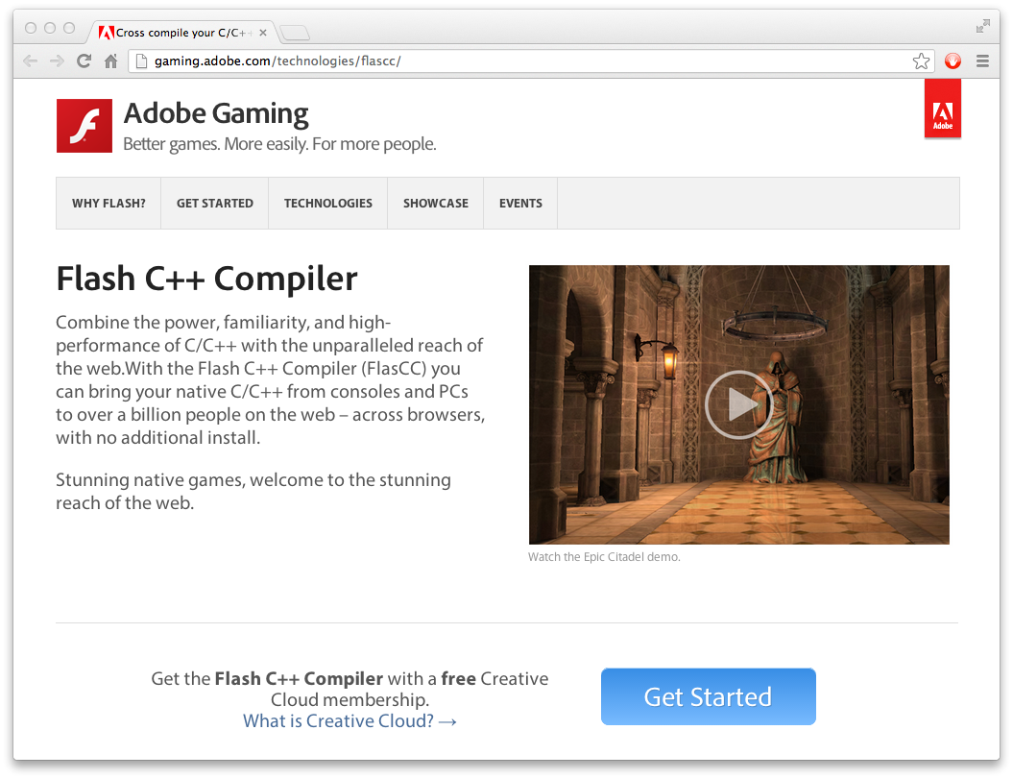
FlasCC
gaming.adobe.com/technologies/flascc/
Free to download
No licensing restrictions on content
Notes:
-- FlasCC released in December, updated in Febuary
-- No longer any plans to charge for the content you generate, FlasCC is completely unencumbered

Slide 5
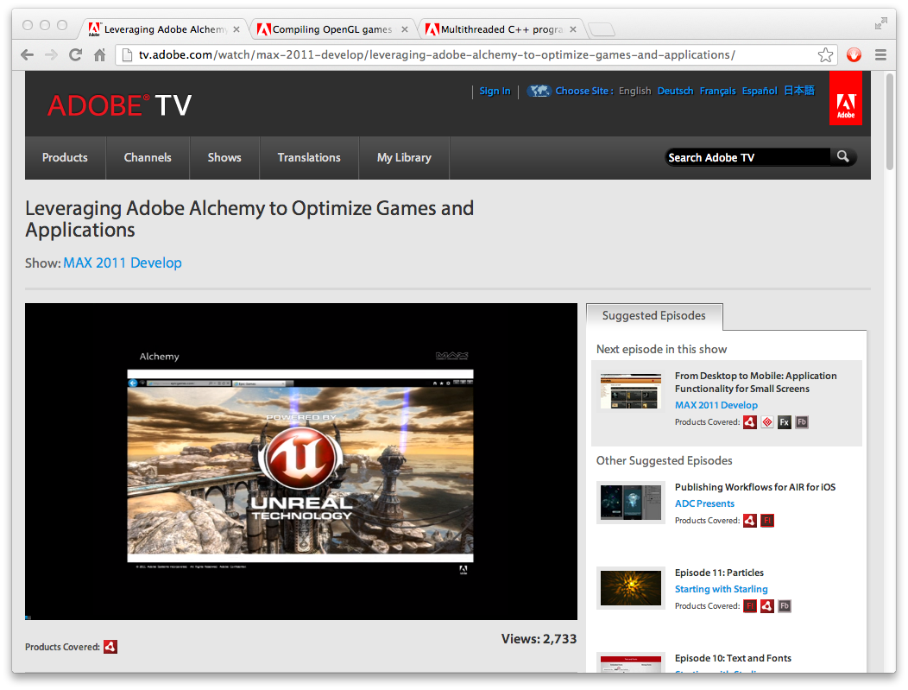
Overview
http://tv.adobe.com/watch/max-2011-develop/leveraging-adobe-alchemy-to-optimize-games-and-applications/
Notes:
-- Unveiled FlasCC at the previous MAX
-- demoed Unreal Engine 3 running in all of the desktop web browsers for the first time
-- DEMO
-- Scott’s talk available on the web, full of useful info about FlasCC

Slide 6

Productivity
Industry standard toolchain
GCC is the compiler
GDB is the debugger
Binutils for the utilities (ar, nm etc)
Robust code generation
LLVM backend
FlasCC passes the GCC “torture test” unit tests
Handles large codebases like Unreal Engine 3
Code reuse
SWIG auto-generates interop code
AS3 developers can use FlasCC SWCs like any other
Notes:
-- Wanted a seamless transition for native developers coming to Flash development
-- went out of our way to match the native toolchains native devs are used to using

Slide 7
Multithreading
Flash 11.5 supports multi-threading
Worker model (isolated execution environments)
AS3 communicates via message passing
domainMemory is shared across workers
FlasCC exposes pthreads
No compromises, fully functional
Mutexes, conditions, rwlocks, semaphores
Thunking mechanism
Similar to “performSelectorOnMainThread”
Run code on main (UI) worker
Manipulate AS3 objects on main worker
Notes:
-- worked with the Flash team to ensure FlasCC had great threading support

Slide 8
Threads vs Workers
Workers
Each worker runs a whole SWF
First SWF to run is the main or “UI” worker → access to privileged APIs
All other workers are child workers → NO access to privileged APIs
Pthreads
FlasCC creates workers running the main SWF
Each worker can run one pthread at a time
A pthread can be impersonated by a different worker
DEMO

Slide 9
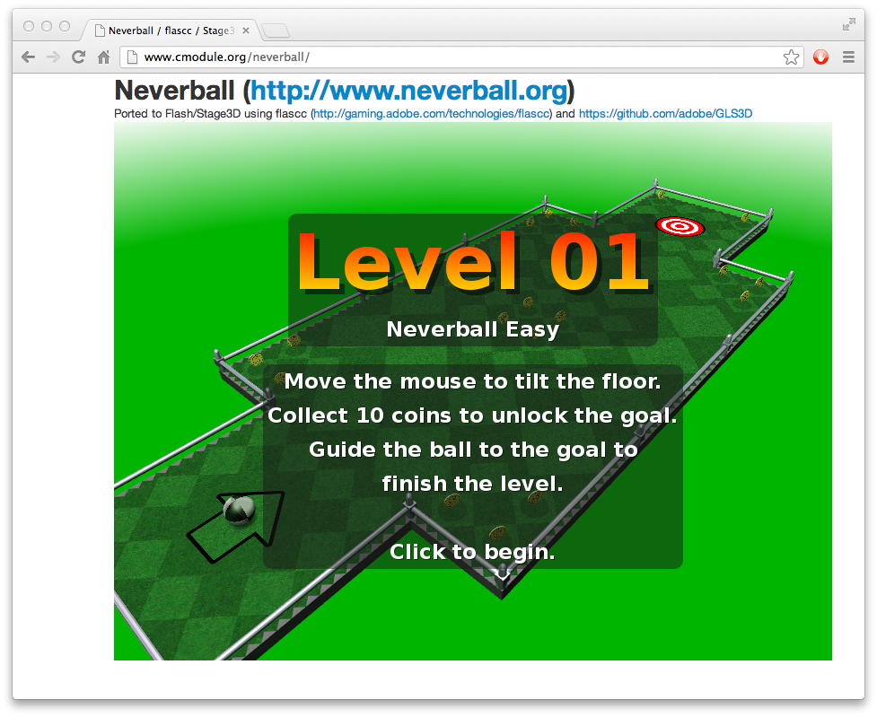
Graphics
Flash 11 introduced Stage3D
GPU accelerated 3D
Equivalent to OpenGLES 2
FlasCC has experimental OpenGL/GLES support
https://github.com/adobe/GLS3D
Gamedev.net “NeHe” OpenGL tutorials
http://www.cmodule.org/nehe/
https://github.com/alexmac/alcfreeglut
DEMO
Neverball
http://www.cmodule.org/neverball/
DEMO
Notes:
-- FlasCC designed with game development in mind
-- Users actively contributing to GLS3D

Slide 10
Graphics - shaders
OpenGL → GLSL (source)
Stage3D → AGAL (bytecode)
GLSL To AGAL
https://github.com/adobe/glsl2agal
http://adobe.github.io/glsl2agal/
DEMO

Slide 11
Porting libraries
Two cases:
Self contained / middle-ware (e.g. libjpeg)
Bottom of the stack / hardware-abstraction (e.g. OpenGL)
1:
Should compile without modification
Need to specify the “target triple” for FlasCC: avm2-unknown-freebsd8
Compile to bitcode for performance (-O4) or ABC for quicker link times
2:
Same as 1, but code needs to be modified
Most libraries have some concept of a “backend”
Use the __AVM2__ or __FLASHPLAYER__ macro to add conditionally compiled code

Slide 12
Extra libraries
https://github.com/alexmac/alcextra
SDL_image / SDL_ttf
Aalib
Eigen
Freetype
Giflib
Gmp
Iconv
Libogg, Libvorbis
Libwebp
Ncurses
Protobuf
DEMO

Slide 13
Porting applications
Pre-Loader
FlasCC default preloader can be replaced
Code for the default included in the SDK
Console.as
The root sprite class that Flash instantiates.
Good place to perform input handling, stage3D setup
Register an enterFrame handler

Slide 14
main()
#include <stdio.h>
struct Foo {
Foo() { printf("Foo ctor\n"); }
~Foo() { printf("Foo dtor\n"); }
};
Foo x;
int main() {
printf("Hello World\n");
}
Foo ctor
Hello World
Foo dtor

Slide 15
main() – AS3_GoAsync()
#include <stdio.h>
#include <AS3/AS3.h>
struct Foo {
Foo() { printf("Foo ctor\n"); }
~Foo() { printf("Foo dtor\n"); }
};
Foo x;
int main() {
printf("Hello World\n");
AS3_GoAsync();
}
Foo ctor
Hello World

Slide 16
Dealing with run loops
while(gameRunning) {
handleInput();
renderFrame();
}

Slide 17
Dealing with run loops
while(flashPlayerRunning) {
handleInput();
//Execute AS3 enterFrame
{
while(gameRunning) { // This blocks outer loop!
handleInput();
renderFrame();
}
}
renderFrame();
}

Slide 18
Dealing with run loops
while(flashPlayerRunning) {
handleInput();
//Execute AS3 enterFrame
{
if(gameRunning) {
handleInput();
renderFrame();
}
}
renderFrame();
}

Slide 19
High level flow
PreLoader
Console.as
constructor()
{
Cmodule.startAsync()
}
enterFrameHandler()
{
}
ISpecialFile Interface
read() { … }
write() { … }
fcntl() { … }
C++ Code
int main() {
AS3_GoAsync()
}
void engineTick() {
}
LibC / syscalls
printf()
…

Slide 20
Dealing with run loops
while(gameRunning) {
handleInput();
renderFrame();
}

Slide 21
Dealing with run loops
while(flashPlayerRunning) {
handleInput();
//Execute AS3 enterFrame
{
CModule.serviceUIRequests()
}
renderFrame();
}
while(backgroundWorkerRunning) {
//Execute AS3
{
while(gameRunning) { // This blocks outer loop, but that's OK.
handleInput();
renderFrame();
avm2_ui_thunk(doStuffOnMainThread);
}
}
}

Slide 22
High level flow - multithreaded
Console.as (UI Worker)
constructor() {
Cmodule.startBackground()
}
enterFrameHandler()
{
Cmodule.serviceUIRequests()
}
ISpecialFile Interface
read() { … }
write() { … }
fcntl() { … }
C++ Code (Background)
int main() {
while(true) {
doStuff()
avm2_ui_thunk(doStuffOnMain)
}
}
void doStuffOnMain () {
...
}
LibC / syscalls (Background)
printf()
…

Slide 23
High level flow - multithreaded
C++ Code (Background)
int main() {
while(true) {
doStuff()
avm2_ui_thunk(doStuffOnMain)
}
}
void doStuffOnMain () {
...
}
LibC / syscalls (Background)
printf() ) { avm2_ui_thunk(...) }
…
Console.as (UI Worker)
constructor() {
Cmodule.startBackground()
}
enterFrameHandler()
{
Cmodule.serviceUIRequests()
}
ISpecialFile Interface
read() { … }
write() { … }
fcntl() { … }

Slide 24
Console.as
public function Console()
{
if(CModule.runningAsWorker()) {
return;
}
...
}
Notes:
-- pthreads run on workers
-- workers run SWFs
-- each worker will run the Console.as ctor

Slide 25
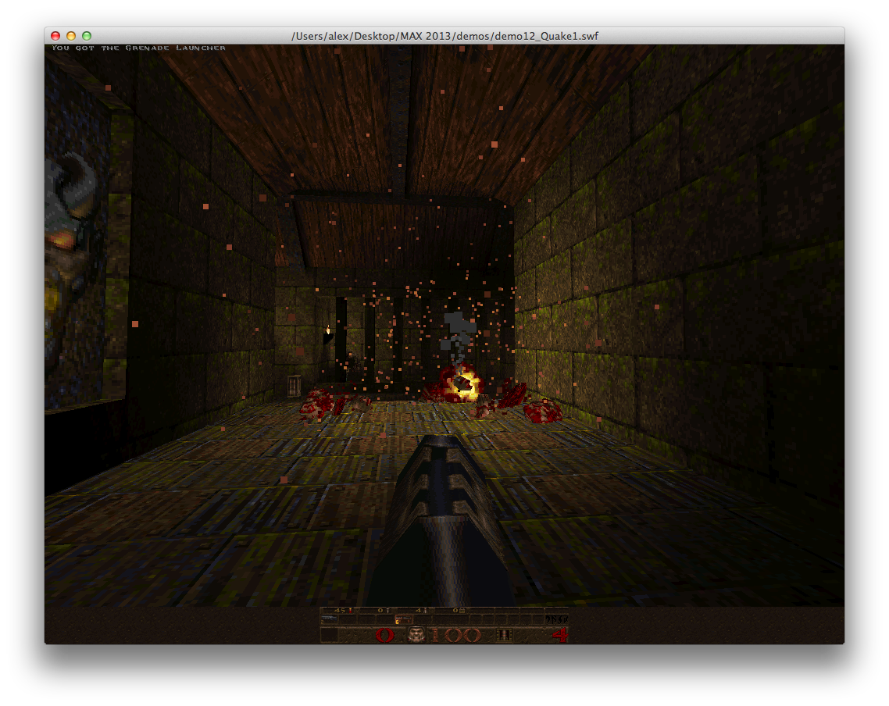
Example ports
FlasCC SDK
Quake 1
Broken run loop for Flash < 11.5
Background thread for Flash >= 11.5
Bullet Physics
Box2D
Lua
DEMO

Slide 26
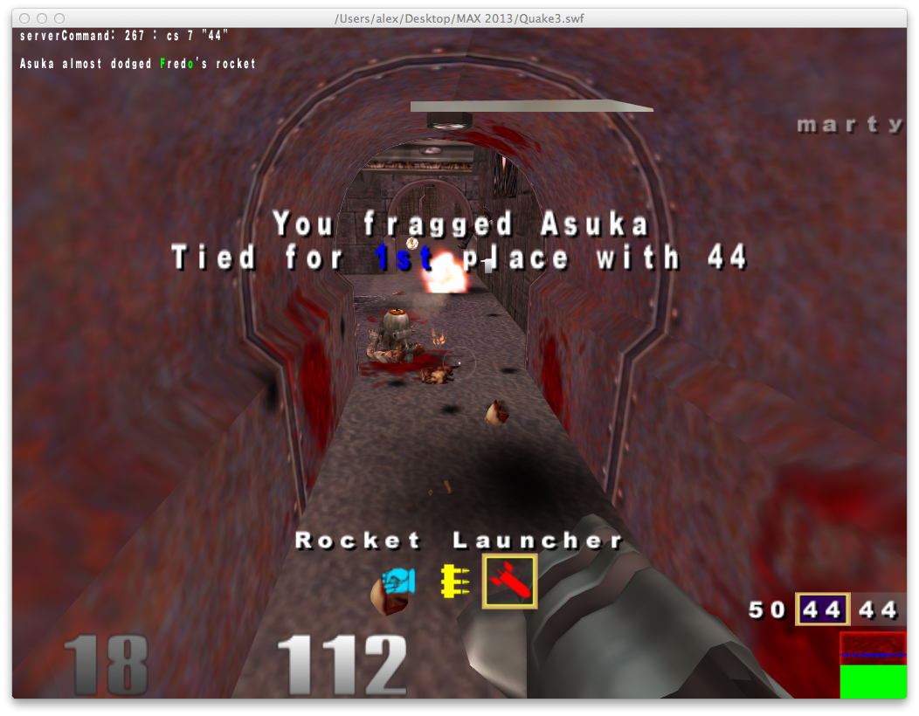
Example ports
https://github.com/alexmac/alcexamples
OpenCV
Quake3
Bochs
DosBox
NetHack
Neverball
DEMO

Slide 27
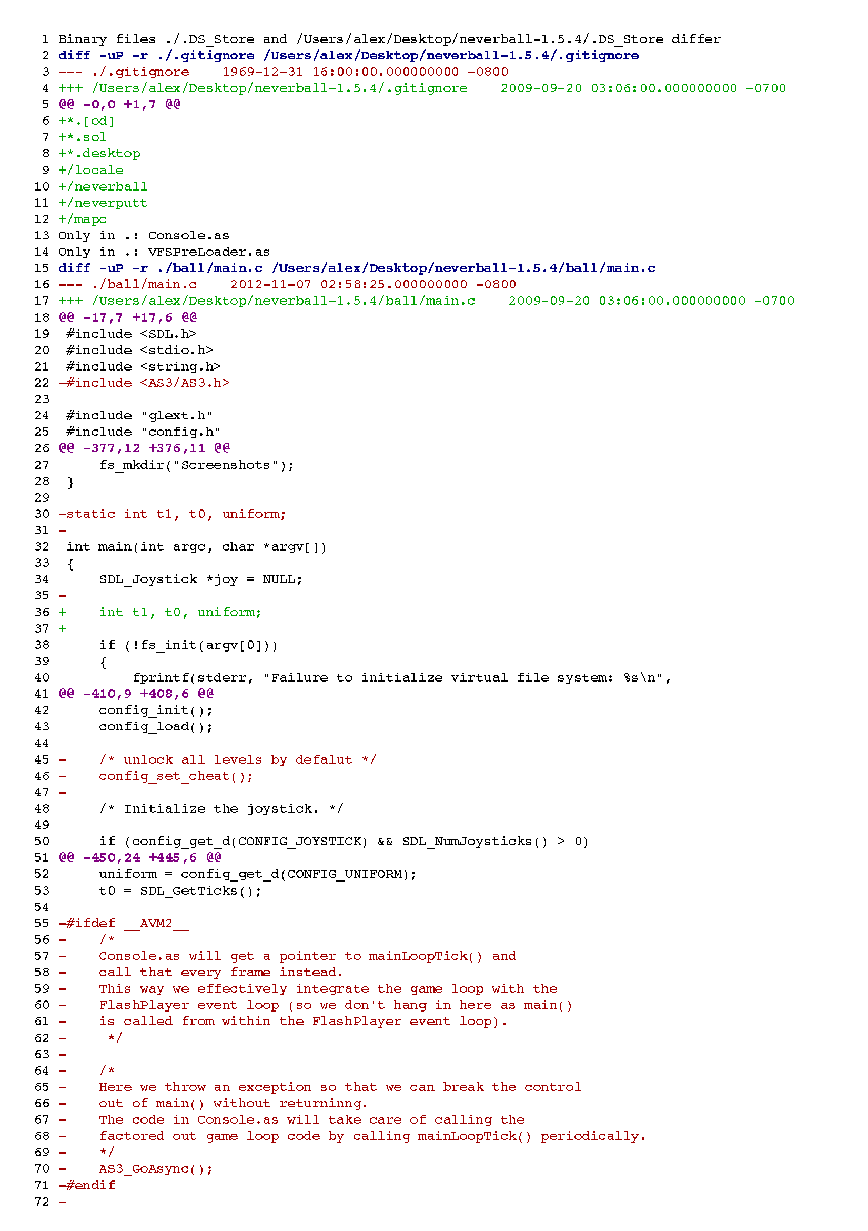
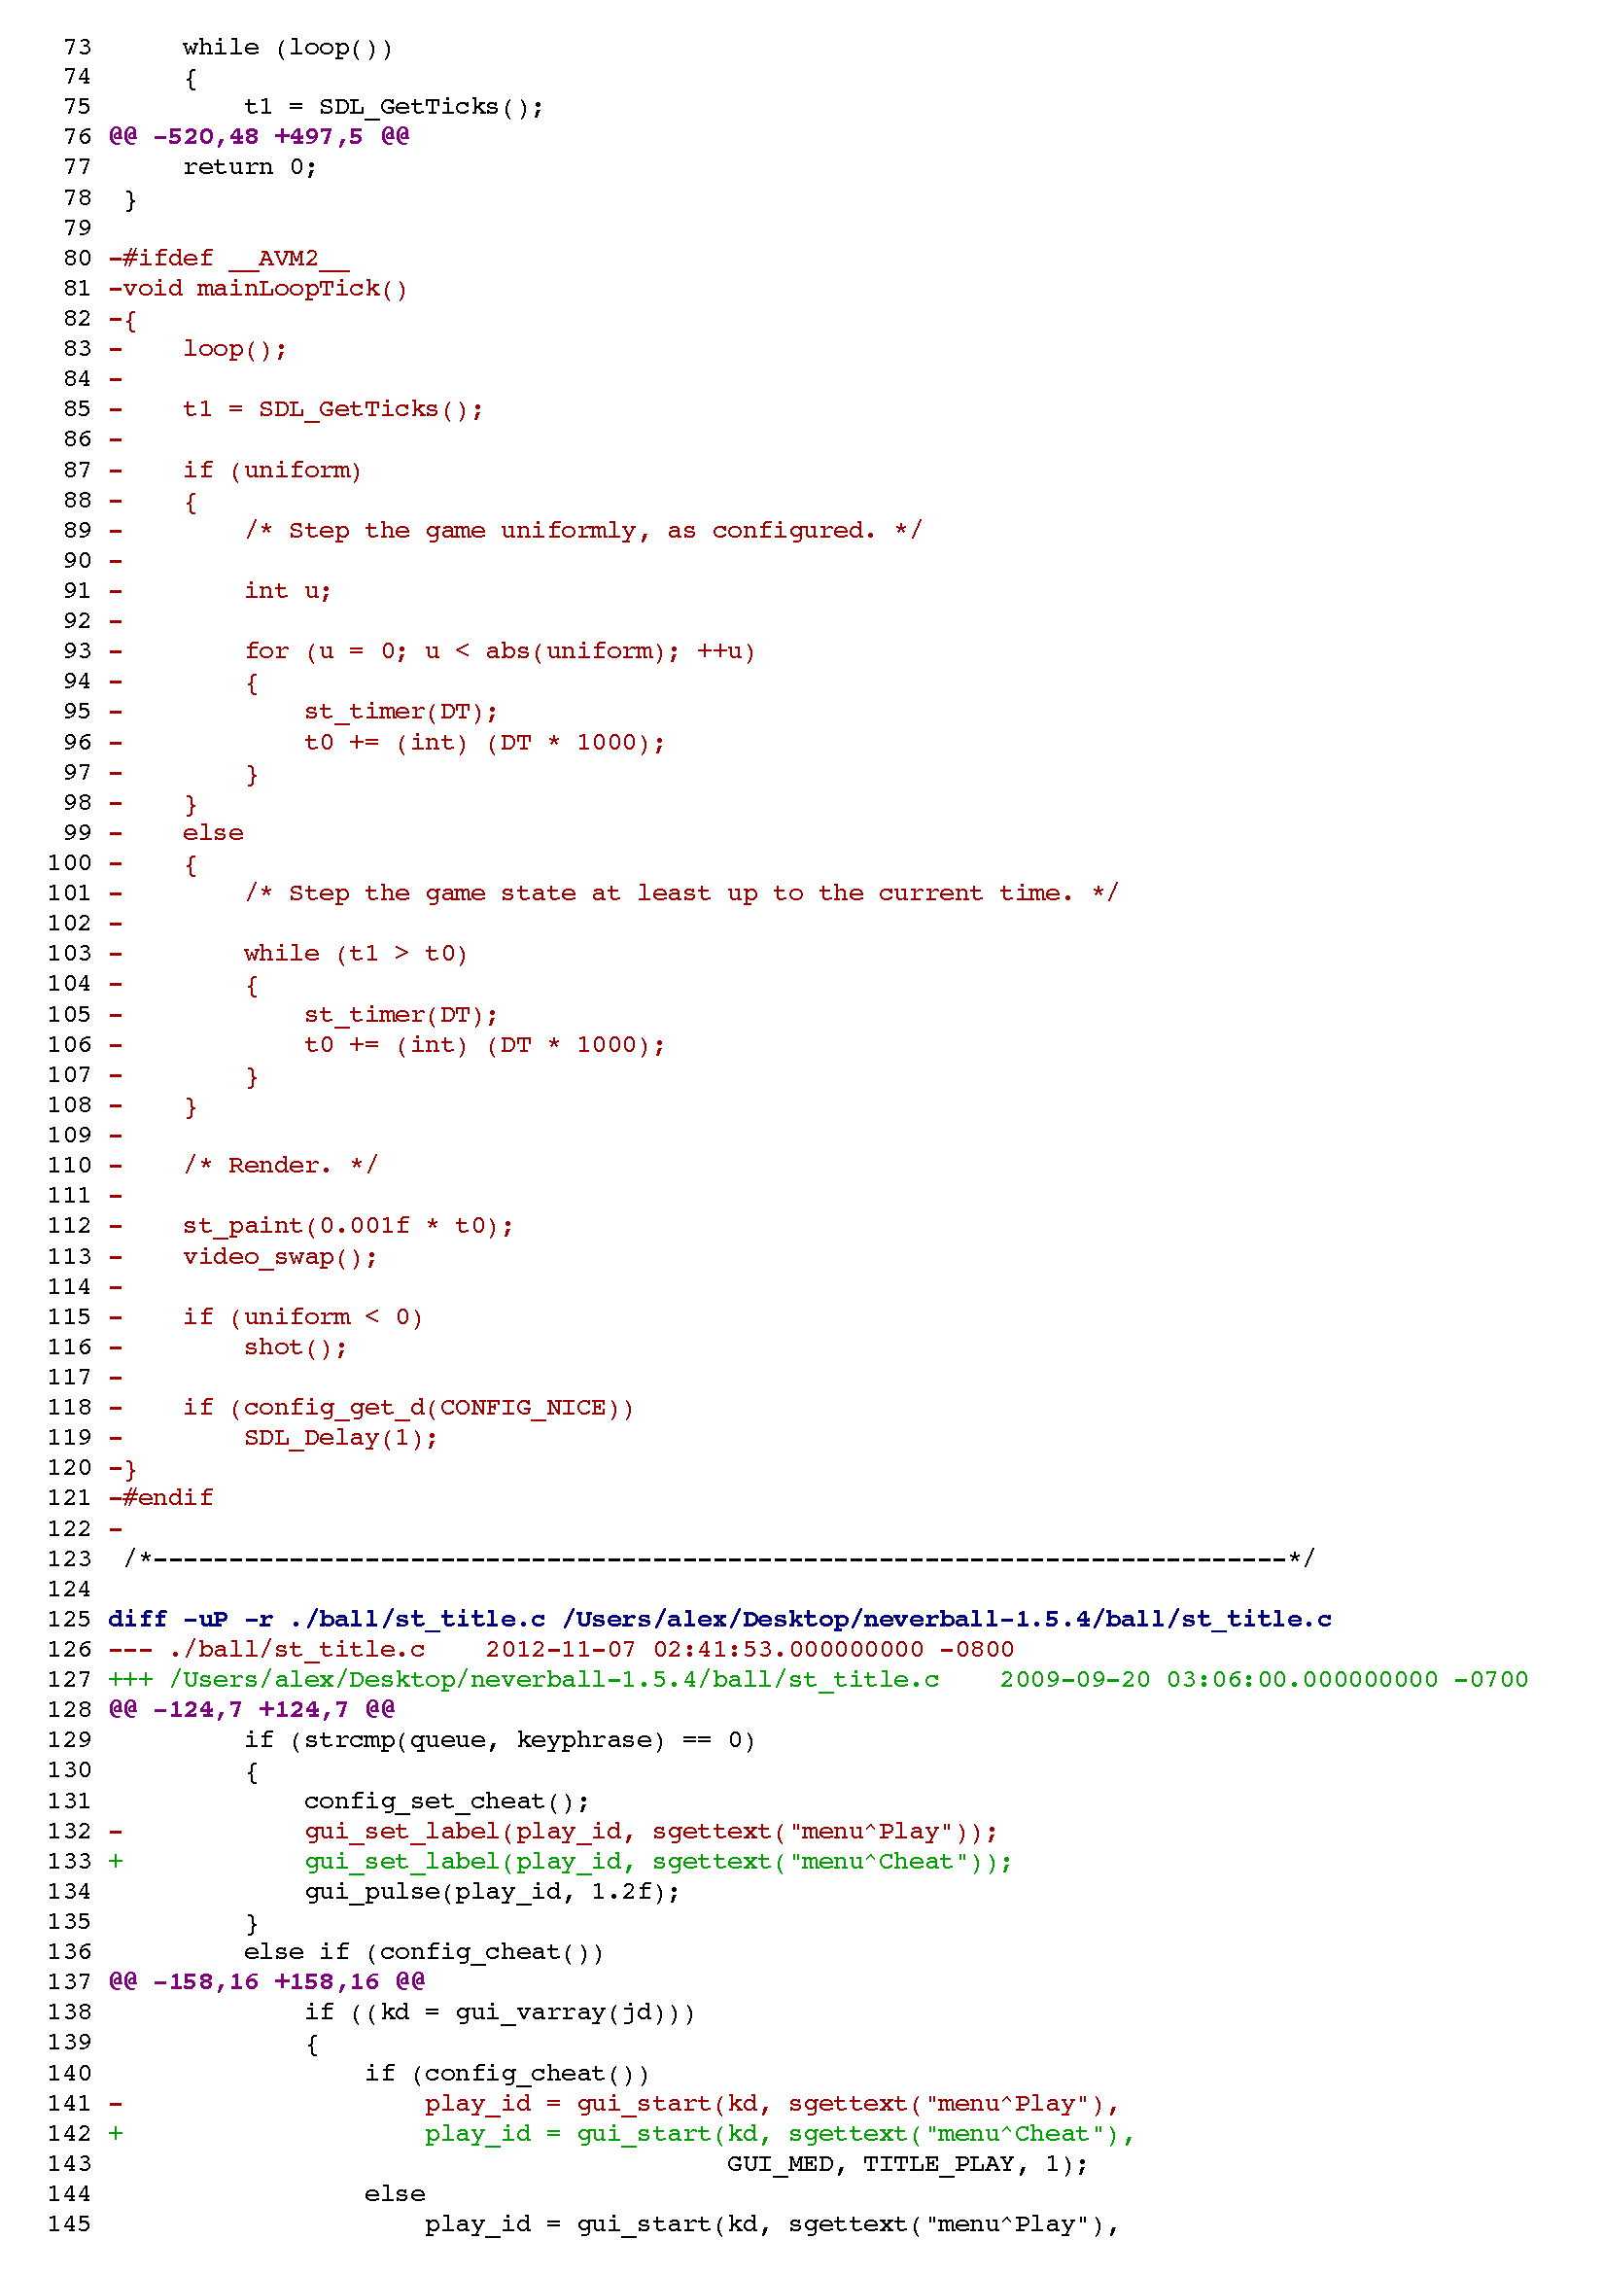
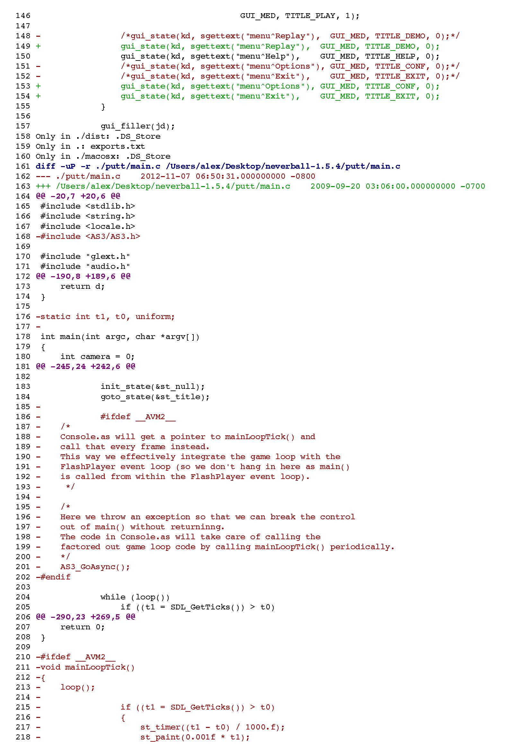
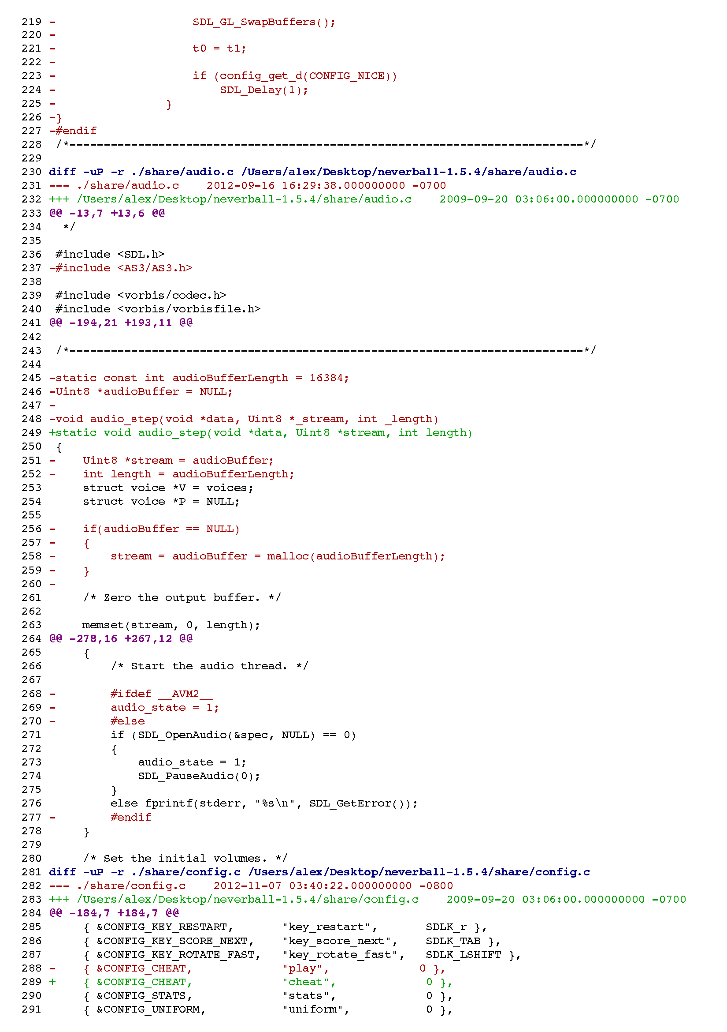
Neverball diff

Slide 28
The Virtual file system
Unix style FS rooted at “/”
Implement the IBackingStore interface
Subclass InMemoryBackingStore
HTTPBackingStore
LSOBackingStore
ZipBackingStore (see Neverball example)
Add the backing store:
CModule.vfs.addBackingStore(yourBackingStore, path)
E.g.
“/data” → HTTPbackingStore
“/user” → LSOBackingStore

Slide 29
Flash++
AS3 APIs reflected into C++ APIs
AS3 namespace → C++ namespace
AS3 property → C++ members
AS3 method → C++ method
Works for arbitrary ABCs
AS3WIG.jar is the tool
Sample 12 uses it for AGALAssembler.abc

Slide 30
Flash++
#include <vector>
#include <AS3/AS3.h>
#include <Flash++.h>
using namespace AS3::ui;
int main()
{
flash::display::Stage stage = internal::get_Stage();
flash::display::Sprite mySprite = flash::display::Sprite::_new();
flash::display::Graphics graphics = mySprite->graphics;
graphics->beginFill(0xff00ff, 0.5);
graphics->drawCircle(0.0, 0.0, 30.0);
graphics->endFill();
stage->addChild(mySprite);
}

Slide 31
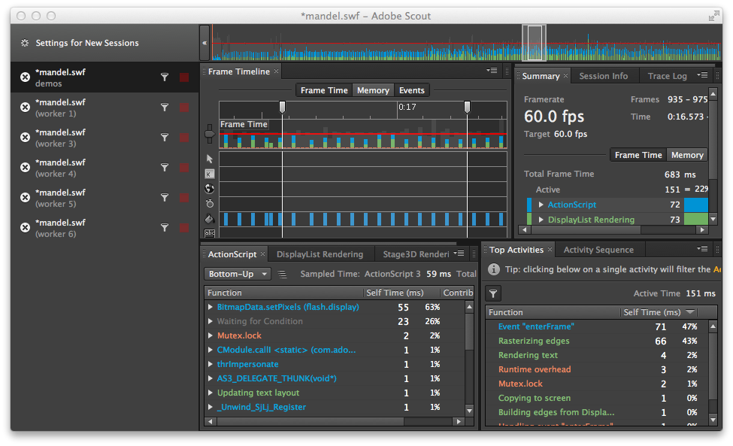
Profiling with Scout
http://gaming.adobe.com/technologies/scout/

Slide 32
Profiling with Scout
Demangles C/C++ function names
Tracks domainMemory usage separately from other ByteArrays
Experimental support for Threading
Custom metrics can be generated from C/C++ code
DEMO

Slide 33
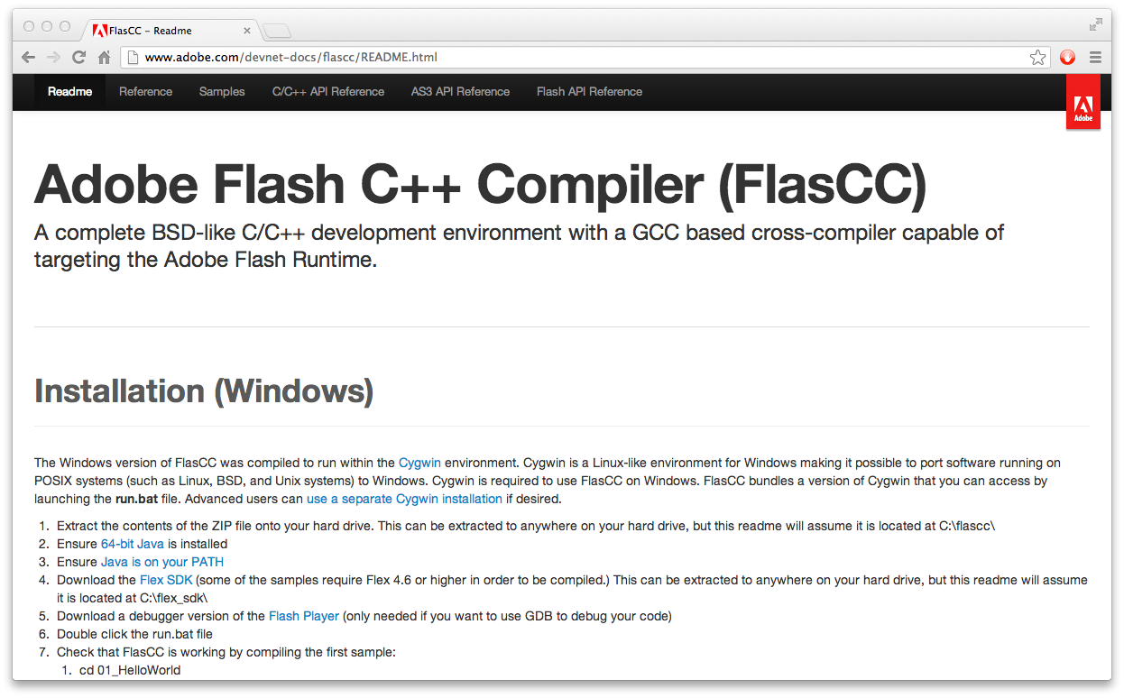
FlasCC documentation
http://www.adobe.com/devnet-docs/flascc/README.html

Slide 34
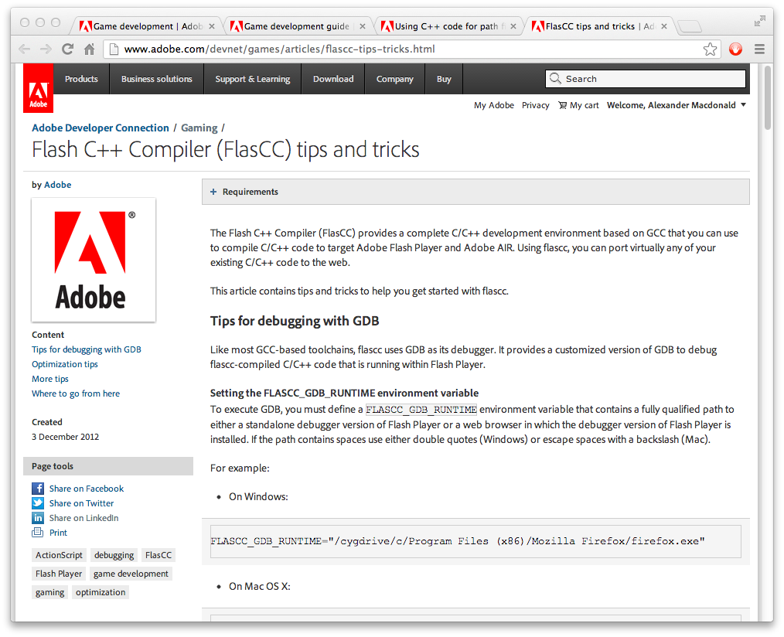
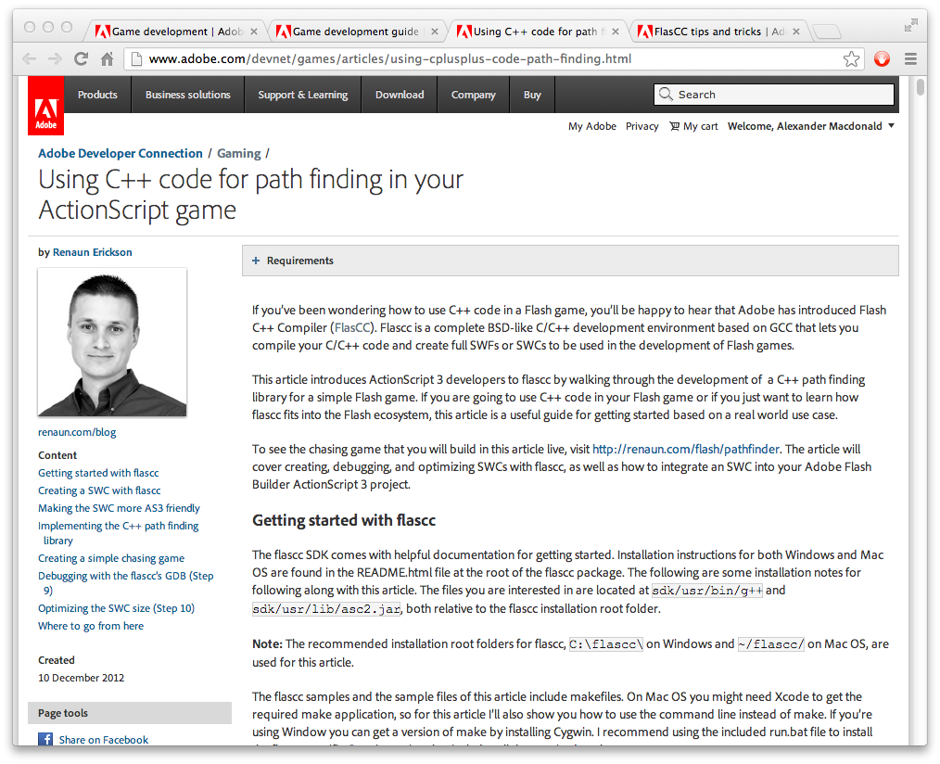
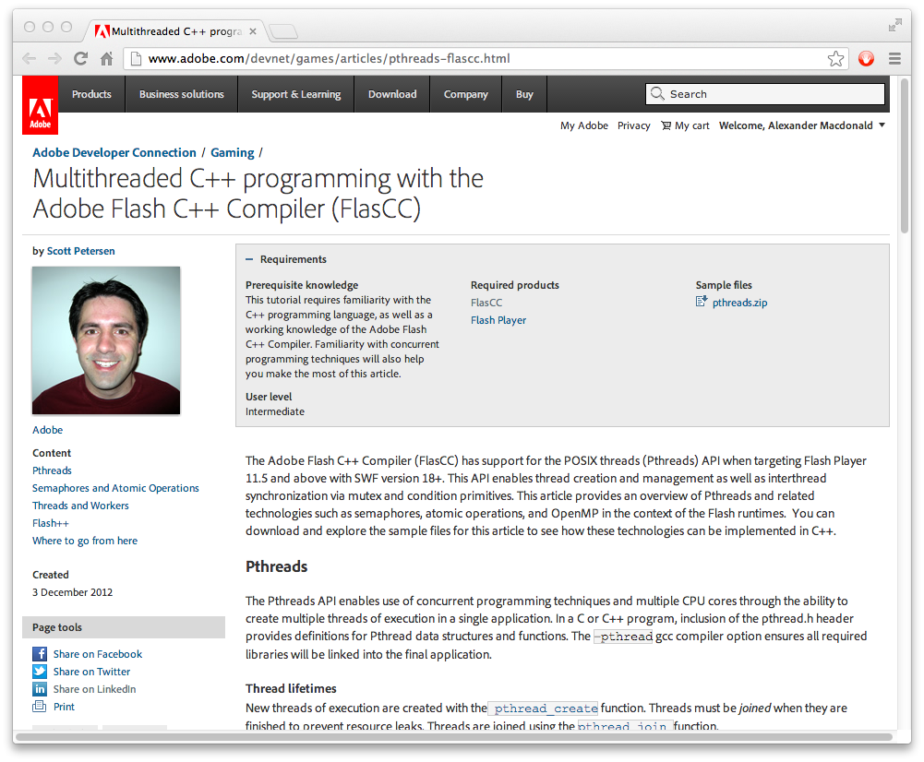
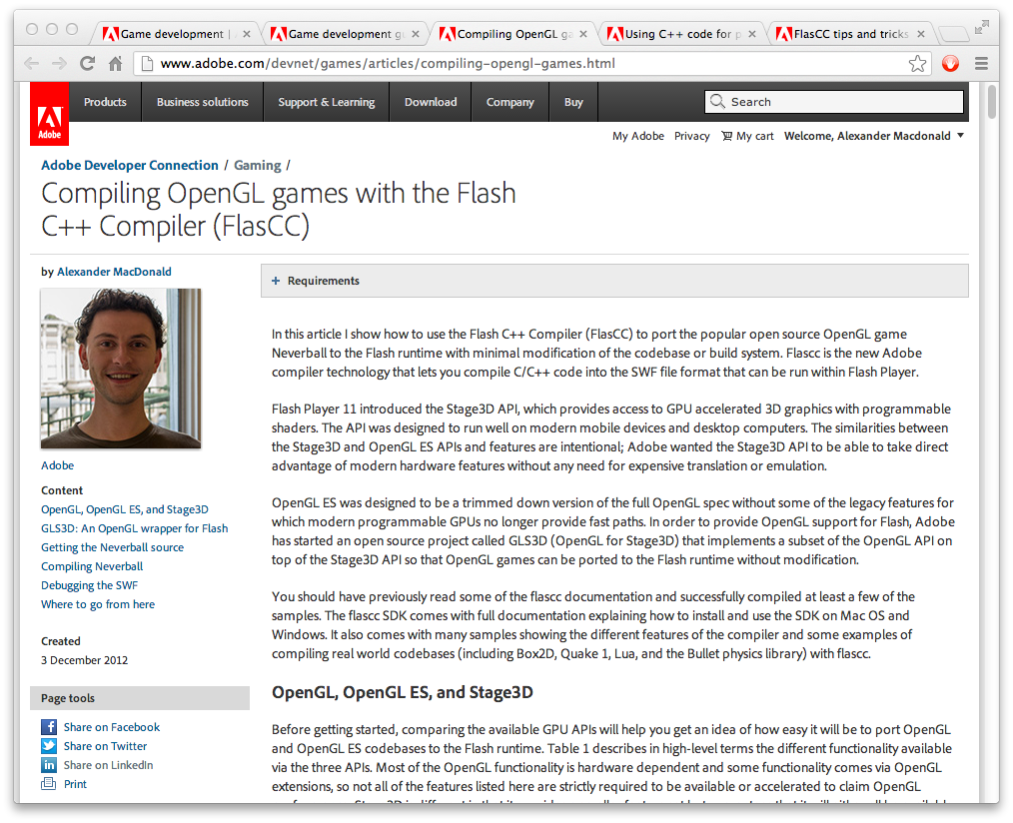
Adobe Devnet articles
http://www.adobe.com/devnet/games/game-development.html#gameflascc

Slide 35
Future
Whole toolchain being open sourced
Adobe will continue to support FlasCC
Alchemy → FlasCC → CrossBridge

Slide 36
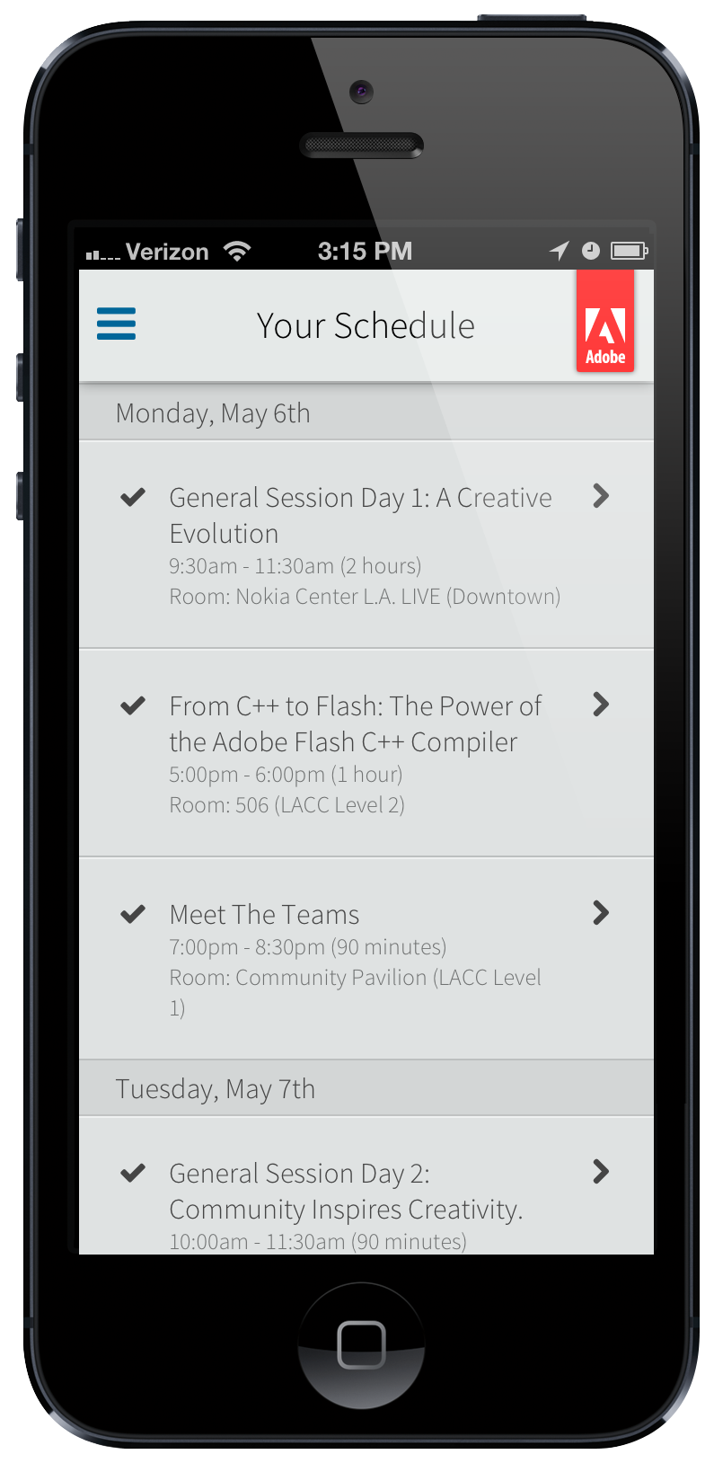

alexmac@adobe.com
@dralexmac

